Slide 1
#03 Arrays and Collections
Notes:
Give an explanation for the concepts array and collections
Relevant theoretical decisions
What is an array, for what and how is it used?
What is an ArrayList, for what and how is it used?
What is the difference between an ArrayList and an array?
Which other collections (Map, List, ...) have you knowledge about?
What do you understand by the concept generic type, how is it used and what is its purpose?
What is a foreach loop and what is its purpose?

Slide 2
.Net Framework and Arrays
Type Safe
Array, List, Dictionary, Sorted Dictionary, Queue and Stack
Interfaces IEnumerable and ICollection
Notes:
most of these collection classes are now type-safe, making for a greatly enhanced programming experience. These classes include the Array, List, Dictionary, Sorted Dictionary, Queue, and Stack.
The .NET Framework provides a number of interfaces, such as IEnumerable and ICollection, whose implementation provides you with standard ways to interact with collections.

Slide 3
Array
Array is a Object that contains Objects
Indexed Collection of Objects, all of the same type
Basic declaration and initialization
type[] array-name;
int[] myIntArray;
myIntArray = new int[5];
int[] myIntArray = new int[5] { 2, 4, 6, 8, 10 }
Notes:
An array is an indexed collection of objects, all of the same type. C# arrays are somewhat different from arrays in C++ because they are objects. This provides them with useful methods and properties.
Technically, you are declaring a variable (myIntArray) that will hold a reference to an array of integers. As always, we’ll use the shorthand and refer to myIntArray as the array, knowing that we really mean a variable that olds a reference to an (unnamed) array.
It is possible to initialize the contents of an array at the time it is instantiated by providing a list of values delimited by curly brackets ({}).

Slide 4
ArrayList

Slide 5
ArrayList

Slide 6
Collections

Slide 7
Indexers, Stack and Dictionaries

Slide 8
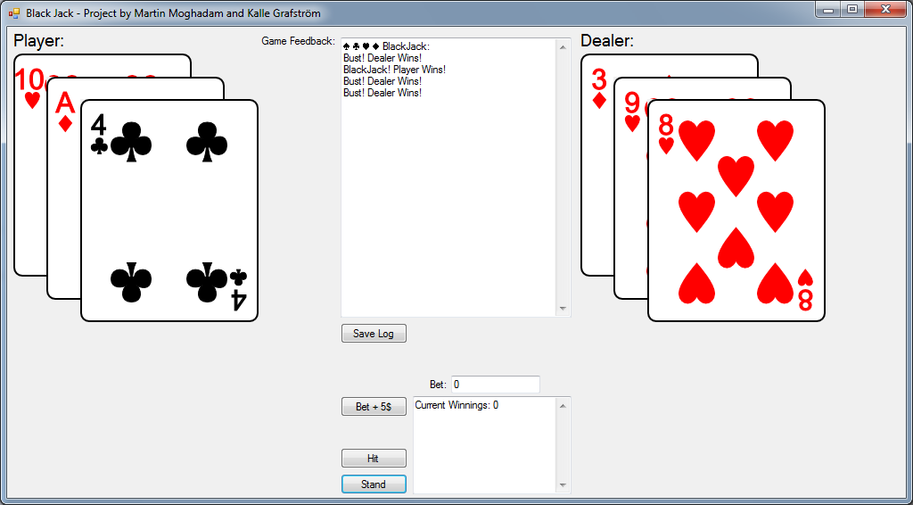
Our program
Black Jack Game
Log
Save Log
Beting
Hit
Stand

Slide 9
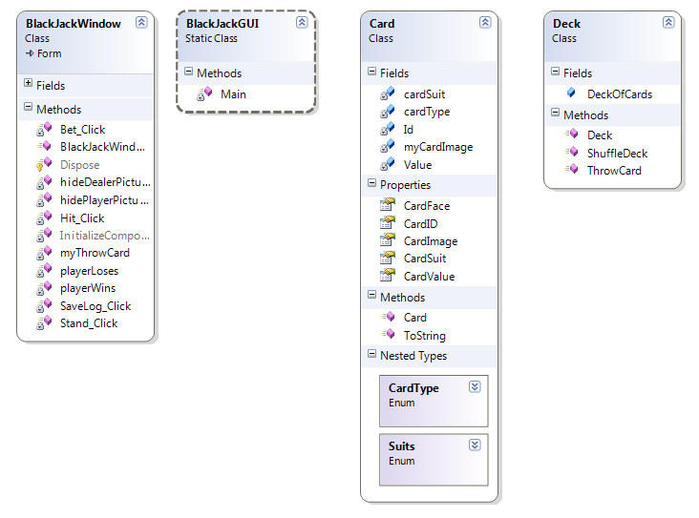
Our program

Slide 10
Use in our program

Slide 11
Questions?

